Slide 1


INSTITUTE FOR ADVANCED COMPUTING AND SOFTWARE DEVELOPMENT AKURDI, PUNE
“NEWS PORTAL”
E-DAC MAY 2021
Submitted By:
Group No:74
Madhavi Bansode 1103
Tanvi Madhale 1102

Slide 2
Outline:
Introduction
Objective
Purpose
Advantages
Module
Activity Diagram
Screen Shot
Conclusion

Slide 3
Introduction
“Payroll Management System” is an internet based Java application that automates the working of a company or work center that manage and maintain records of the employees in the different department This application is created as a product and can be customized according the specific needs of the client.
The objective of “Payroll Management System” is designing a scheduling system for a work centre. Scheduling is such a tool with which the process of intimating activities and notifications will be easy and even online in the organization where it is installed.
But these task of scheduling the different activities if manually done whether they may be personal or official is time consuming and also may lead to confusion if not properly scheduled.
The supervisor which holds the various activities like sending notifications, mark attendance , and deleting the employees and on the other hand employees view their details, view schedule or the notifications or any message form supervisor and view attendance.

Slide 4
Objective
The Payroll Management System it is process with the designing, building and testing a software system that is been used in a company. This includes two modules i.e.
Admin and Employee.
The system will do the following:
1)Admin:
• Admin can Add/Edit/delete the employees.
• Admin can Add/Edit/delete the schedule the work of the employees.
• Admin can Add/Edit/delete mark the attendance of employees.
• Admin can Add/Edit/delete Leaves and time sheet of the employee.
2)Employee:
• Registration according to category (developer, tester and designer).
• Employee can view his/her schedule set by Admin.
• Employee can check his/her attendance.
• Employee can update his/her details.
• Employee can re-set password.

Slide 5
Purpose
The purpose of this web application is for Managing Employees and their payroll. The expected audiences are the developers and the admin of the web application. Now with the help of this system the admin has the information on his finger tips and can easily prepare a good record based on their requirements.
This system will automate the whole process.
It will also save the valuable time of the manager or the admin, which can be well utilized buy his/her company.
This will be an additional advantage and management of power based on their free time from his normal duty.

Slide 6
Advantages:
The system has various advantages:
• Transparency to all the user of system.
• Less paper use and removal of redundancy.
• Less prone to errors.
• The whole system is interactive.

Slide 7
HARDWARE AND SOFTWARE REQUIREMENTS
Hardware Requirements:
Processor : Pentium (or above)
RAM : 2 GB
Hard Disk : 40 GB
Software Requirements:
Operating System : Windows XP or above
Java Runtime Environment : JDK/JRE 1.8 or above
Database Server : MYSQL
Web Server : Apache Tomcat
Browser : Java Script Browser

Slide 8
Modules
Admin
Employee

Slide 9
Use Case Diagram

Slide 10
Data Flow Diagram
The flow of the data around the system is graphically represented by the data flow diagram.
A graphical tool used to describe and analyze the moment of data through a system manual or automated including the process, stores of the data and delays in the system.
Data flow diagram the central tool and the basis from which other components are developed.
DFDs are the model of the proposed system. They clearly show the requirements on which the new system should be built. Later during the design activity this is taken as the basis for drawing the system’s Structure charts.
The various components of DFDs are:
Dataflow: Data movement form the source to destination is shown by the arrows.
Process: The various activities and the actions performed on the data is represented
through circle.
Entities: External sources or information of the data is represented by rectangle.

Slide 11
Level 0 Data Flow Diagram

Slide 12
Level 1 Data Flow Diagram

Slide 13
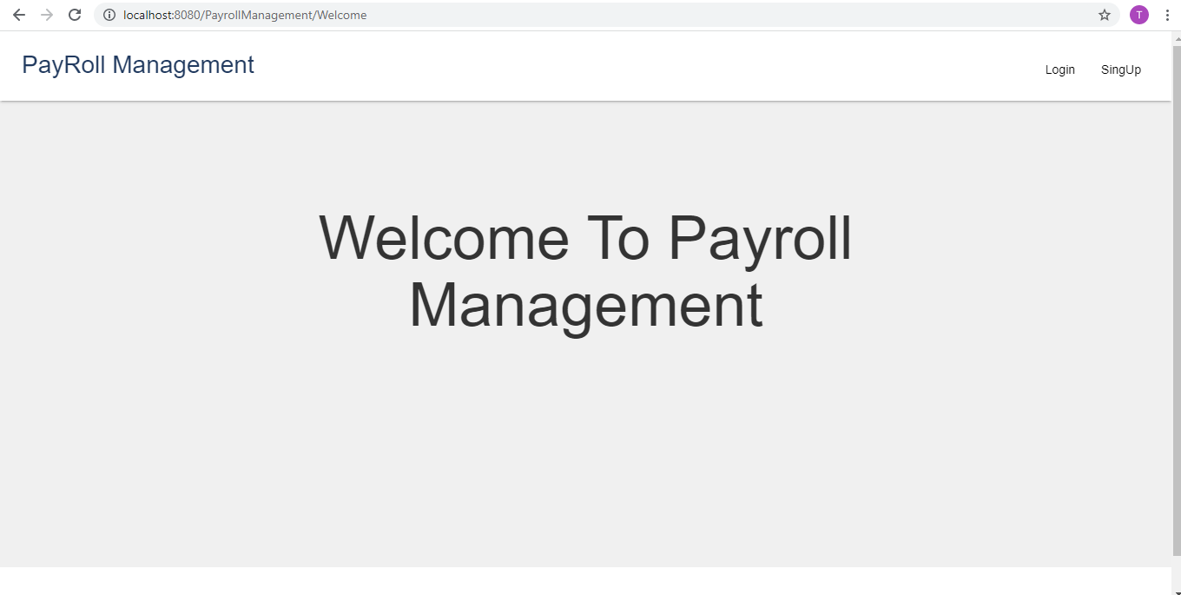
ScreenShots
Welcome Page:

Slide 14
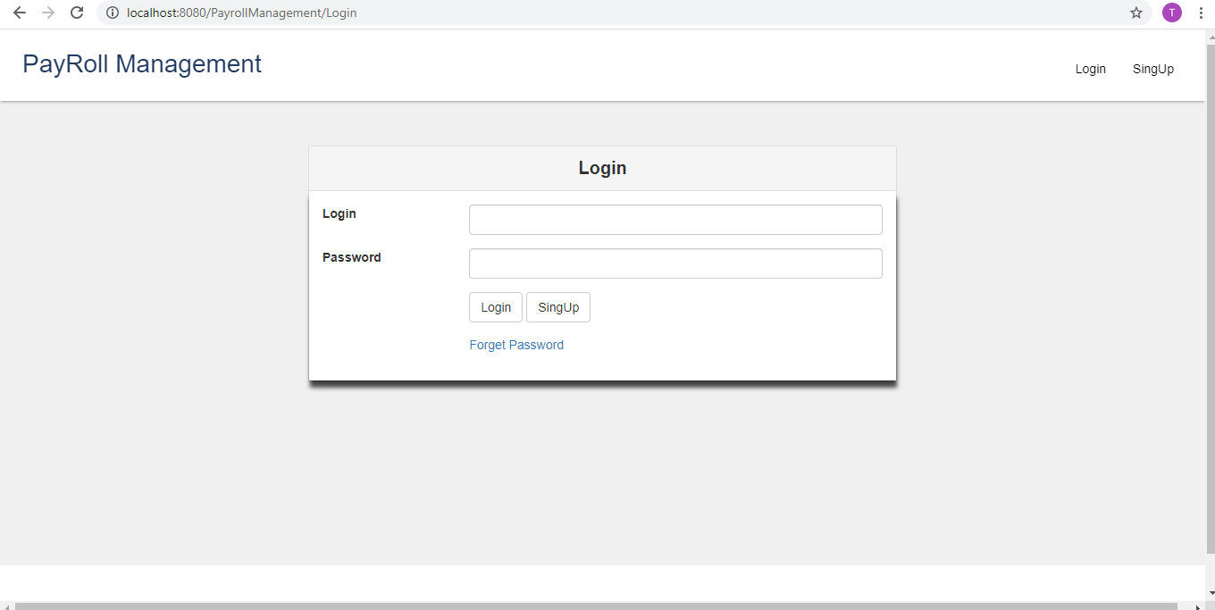
Login:

Slide 15
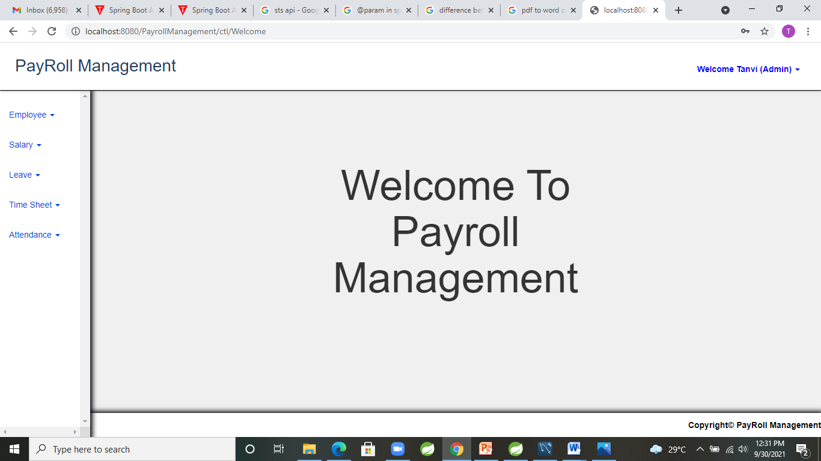
After Login Screen:

Slide 16
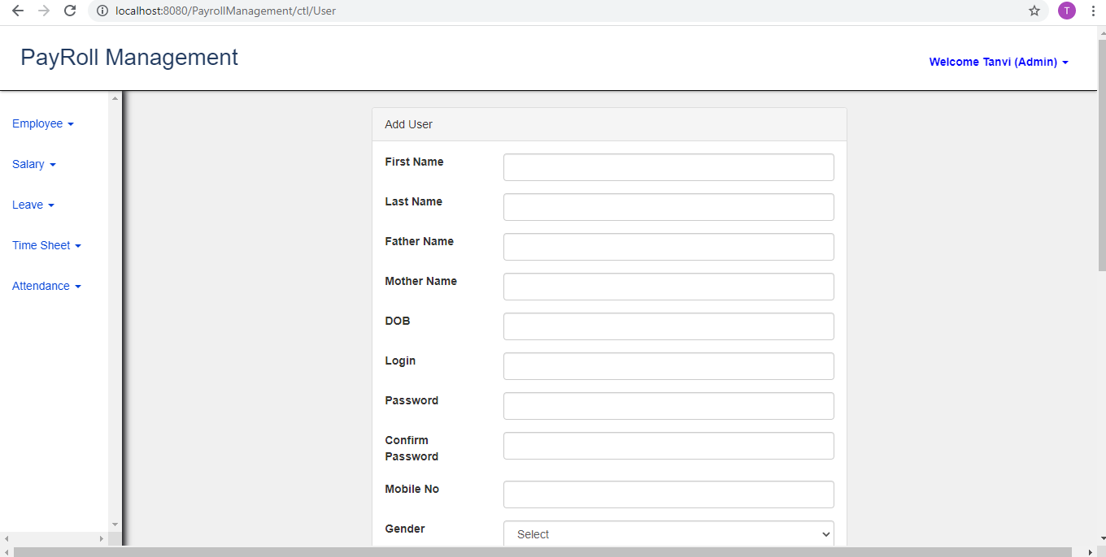
Add Employee:

Slide 17
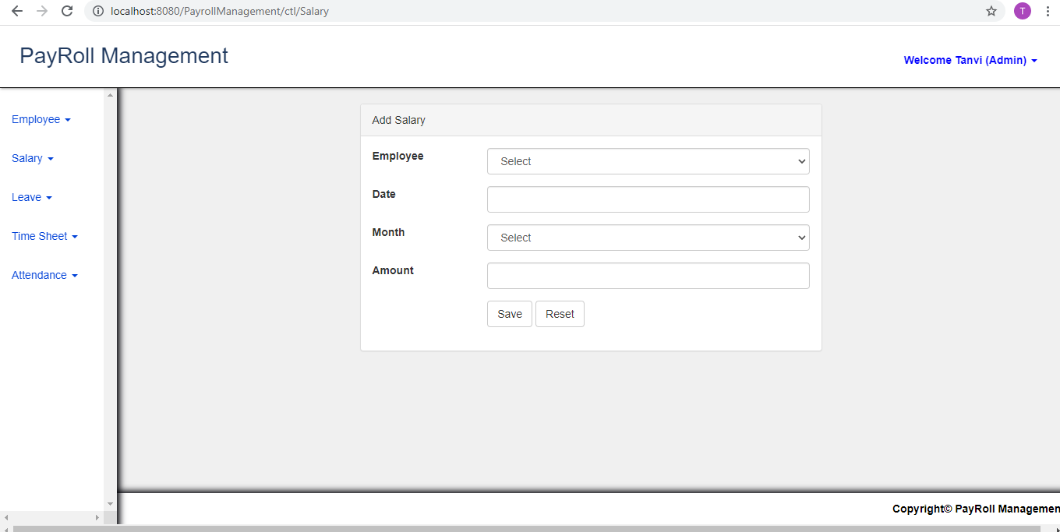
Add Salary:

Slide 18
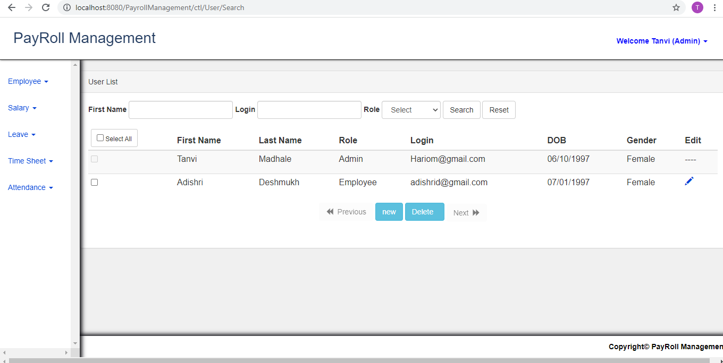
Employee List:

Slide 19
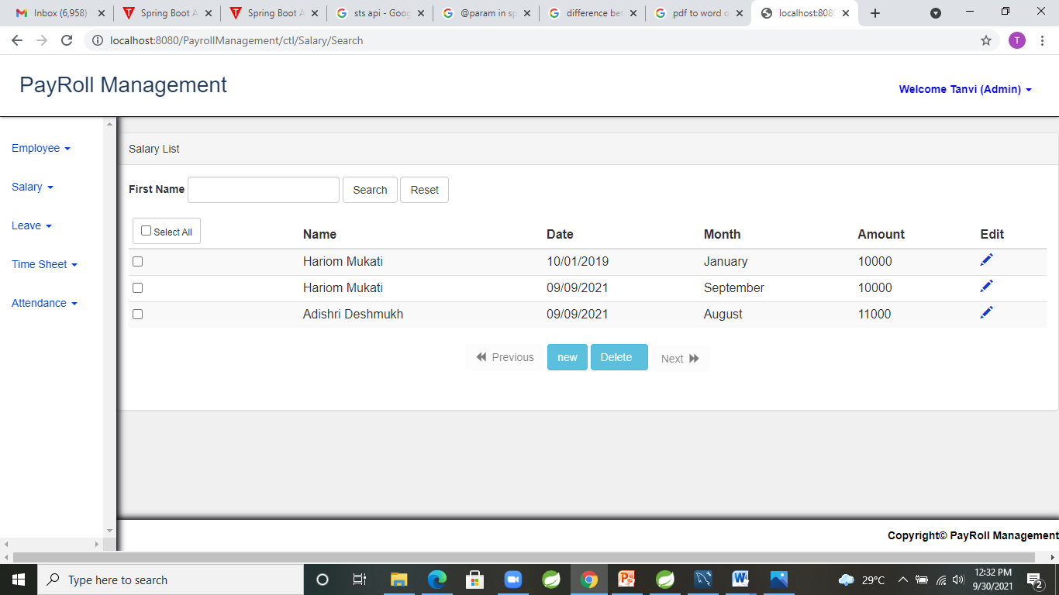
Salary List:

Slide 20
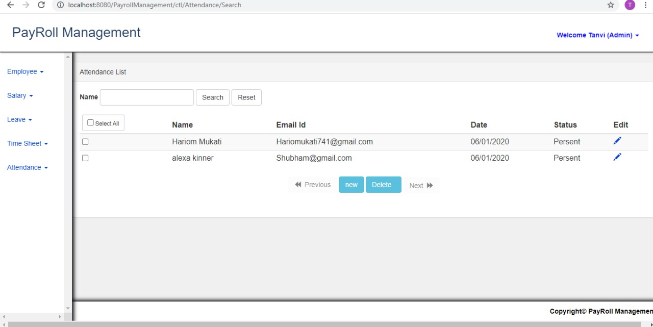
Attendance List:

Slide 21
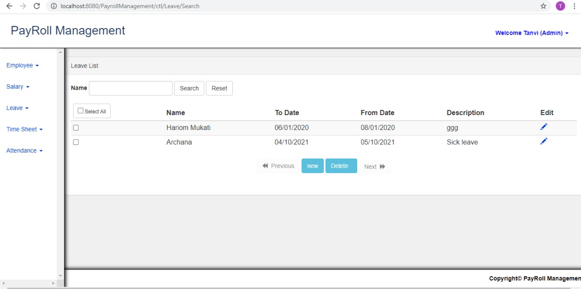
Leave List:

Slide 22
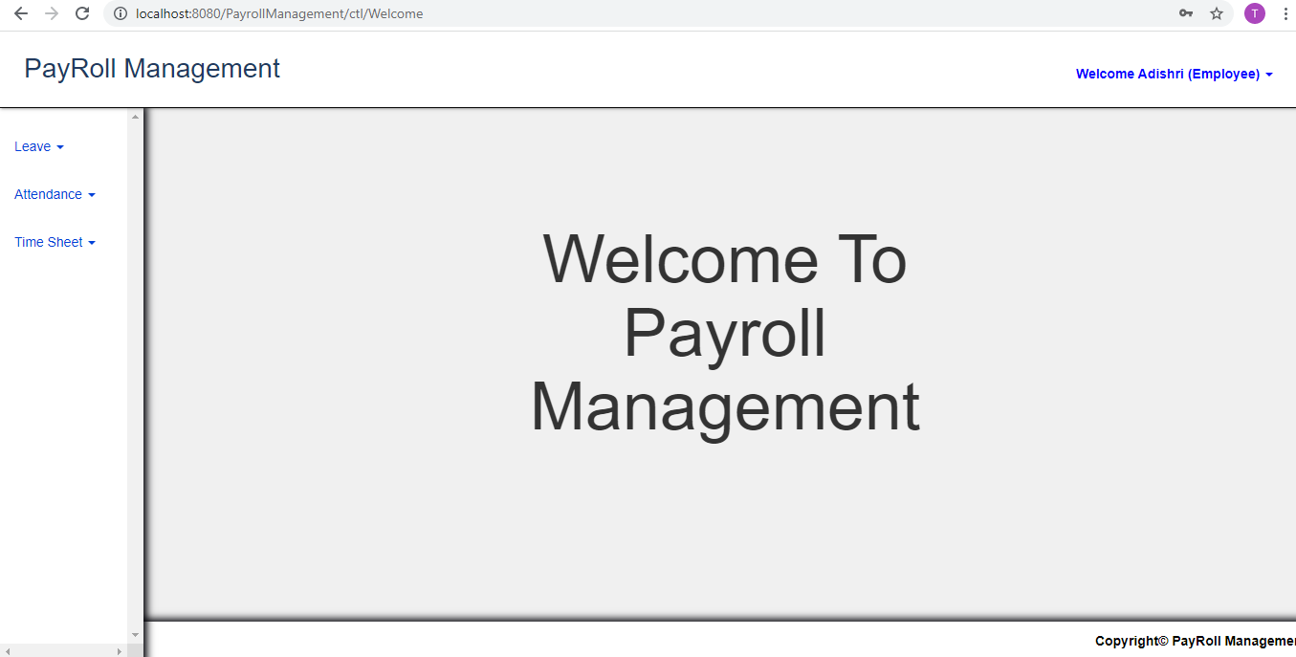
Employee Dashboard:

Slide 23
Conclusion
We conclude, using this application we can easily insert the records and maintain them for long period of time.
There is no chance of losing data and prevents data redundancy.
We have prepared application where no other person other than the admin can make changes in the database.
The main records are to be recorded and handled by the admin employees in order to keep a check on the customers and applicants.

Slide 24
THANK YOU

